Slide 1


K.RAMAKRISHNAN COLLEGE OF TECHNOLOGY
(AUTONOMOUS), TRICHY
WORD COUNTER
PRESENTED BY SUPERVISOR
PADMACHARAN.S Mrs.K.Valli Priyadharshini M.E., (PhD),
23038117104221112 AP/CSE.

Slide 2
PRESENTATION OVERVIEW
1. Objective
2. Project Introduction
3. Problem Statement
4. Methodologies (Programming concepts relevant to problem statement)
5. Architecture of the proposed system
6. List of Modules
7. Merits
8. Results and Discussion
9. Queries

Slide 3
OBJECTIVE
The objective of this Java Word Counter Program is to provide a user-friendly application for analyzing textual data by counting the number of words, characters (with and without spaces), and facilitating basic text processing tasks.
Designed with a graphical user interface (GUI), the program allows users to input text, process it, and instantly view results in an organized format.
It leverages Java's robust features, including event handling and modular design, to ensure seamless interaction between the user and the application.
Additionally, the program aims to enhance text analysis capabilities by incorporating file handling functionality for reading and saving text files, making it a versatile tool for personal, educational, and professional use.
The overall goal is to deliver an efficient, extendable, and interactive solution for text processing tasks.

Slide 4
INTRODUCTION
The Java Word Counter Program is a practical application designed to perform essential text processing tasks such as counting words and characters in a user-provided text input. Built using Java, the program employs a graphical user interface (GUI) to ensure ease of use and an interactive experience. The GUI allows users to input text, view results, and clear or modify the input efficiently.

Slide 5
PROBLEM STATEMENT
In today's digital age, managing and analyzing textual data efficiently is essential for various personal, educational, and professional tasks. However, users often face challenges in accurately counting the number of words and characters in a given text or document, especially when working with large datasets or different text formats. This lack of an accessible, user-friendly, and interactive tool for quick text analysis creates a gap in productivity and ease of use.

Slide 6
METHODOLOGIES
Basic Input/Output
String Handling
Arrays
Conditional Statement
Loops
Classes and Objects

Slide 7
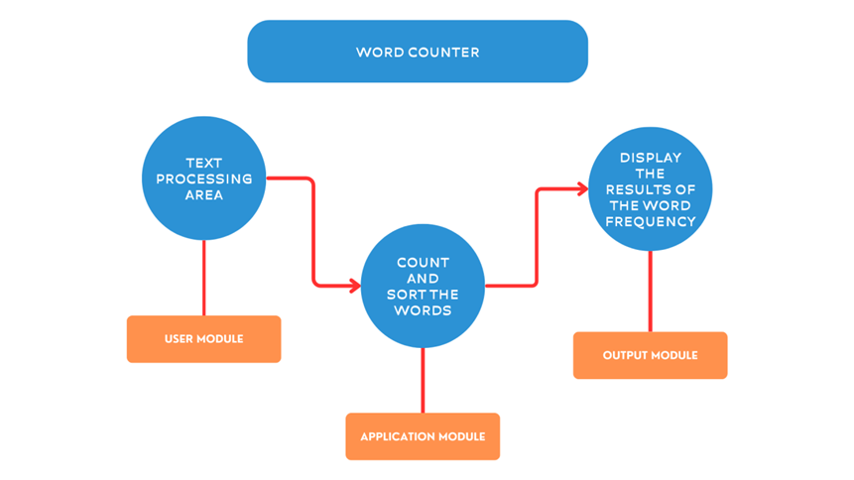
ARCHITECTURE OF THE PROPOSED SYSTEM

Slide 8
LIST OF MODULES
Text Processing Module
GUI Module
Event Handling Module
File Handling Module

Slide 9
Merits
User-Friendly Interface
Modular Design File Handling Support Customizability and Expandability
Educational Value
Error Handling Accuracy and Efficiency

Slide 10
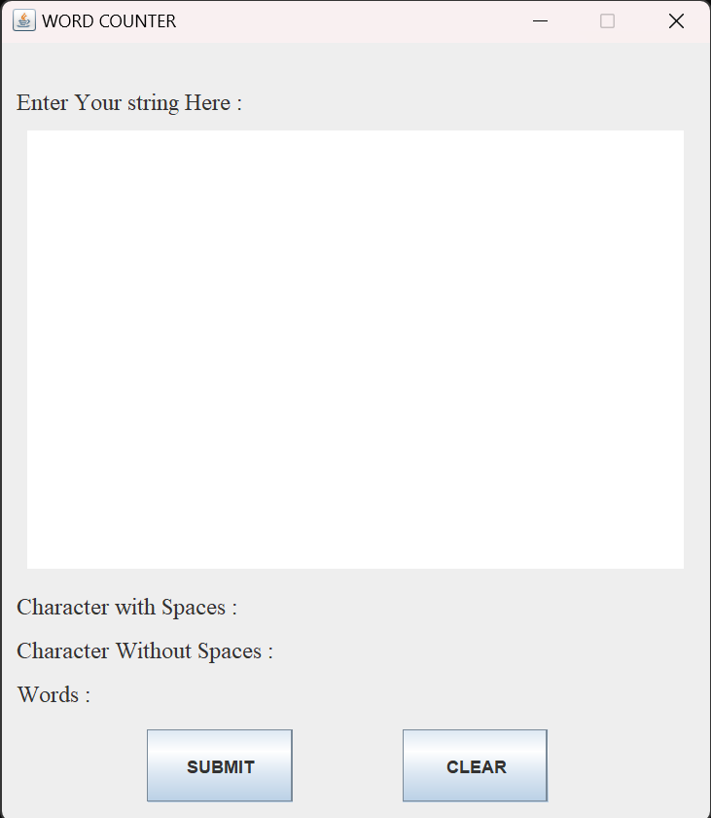
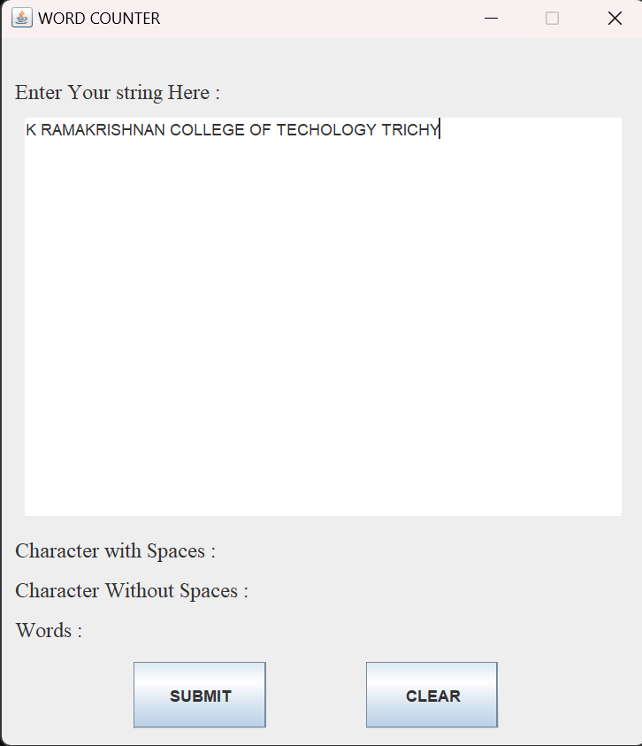
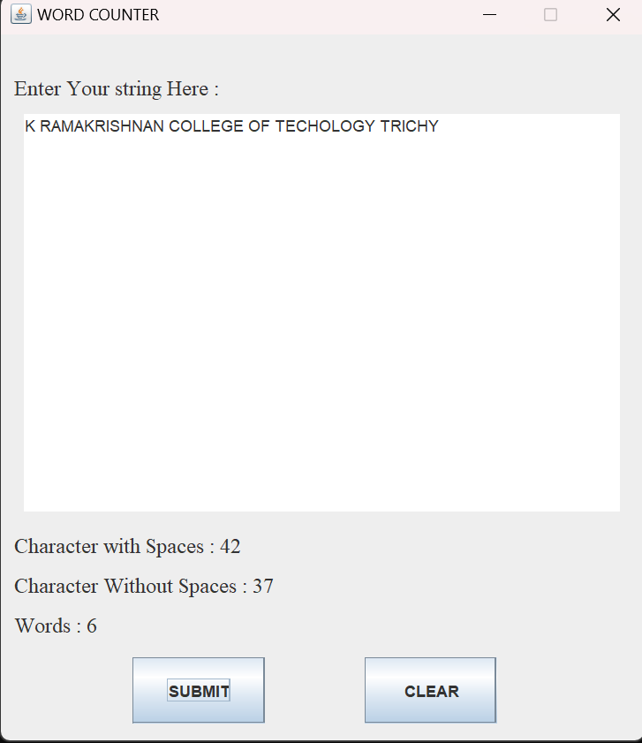
RESULTS
RESULTS : The Word Counter Program in Java successfully achieves its intended functionality by providing an accurate and user-friendly solution for analyzing textual data.

Slide 11
DISCUSSION
The Word Counter Program in Java demonstrates the practical application of fundamental programming concepts to solve a common problem in text processing. This program combines a graphical user interface (GUI) with robust backend logic to deliver an efficient and user-friendly experience. By leveraging Java's Swing library, it creates an intuitive interface for users to input text and view analysis results instantly, showcasing the power of event-driven programming.

Slide 12
QUERIES

